Slide 1

Social Science Research Design and Statistics, 2/e Alfred P. Rovai, Jason D. Baker, and Michael K. Ponton
Sorting Cases and Variables
PowerPoint Prepared by Alfred P. Rovai
IBM® SPSS® Screen Prints Courtesy of International Business Machines Corporation,
© International Business Machines Corporation.

Slide 2
Sorting Cases and Variables
Sort cases (rows) in Data View based on the values of one or more sorting variables.
Sort variables (columns) in Data View based on the values of any variable attributes, e.g., variable name or type data.

Slide 3
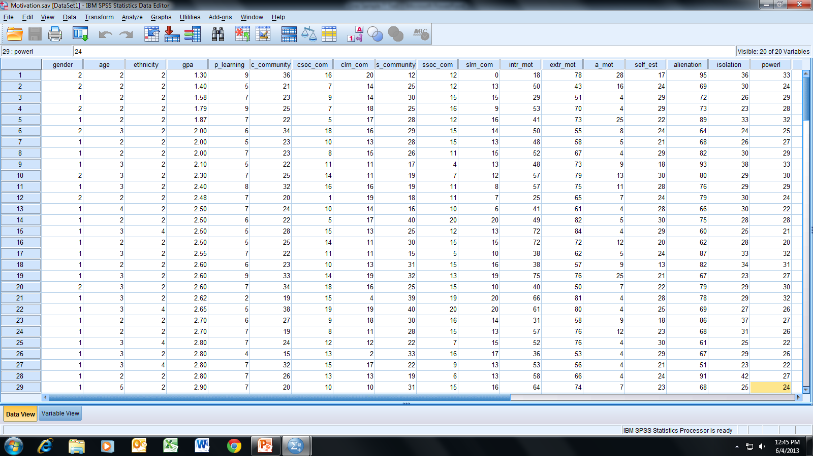
Open the dataset Motivation.sav.
File available at http://www.watertreepress.com/stats
TASK #1
Sort cases in this dataset by
age in ascending order.

Slide 4
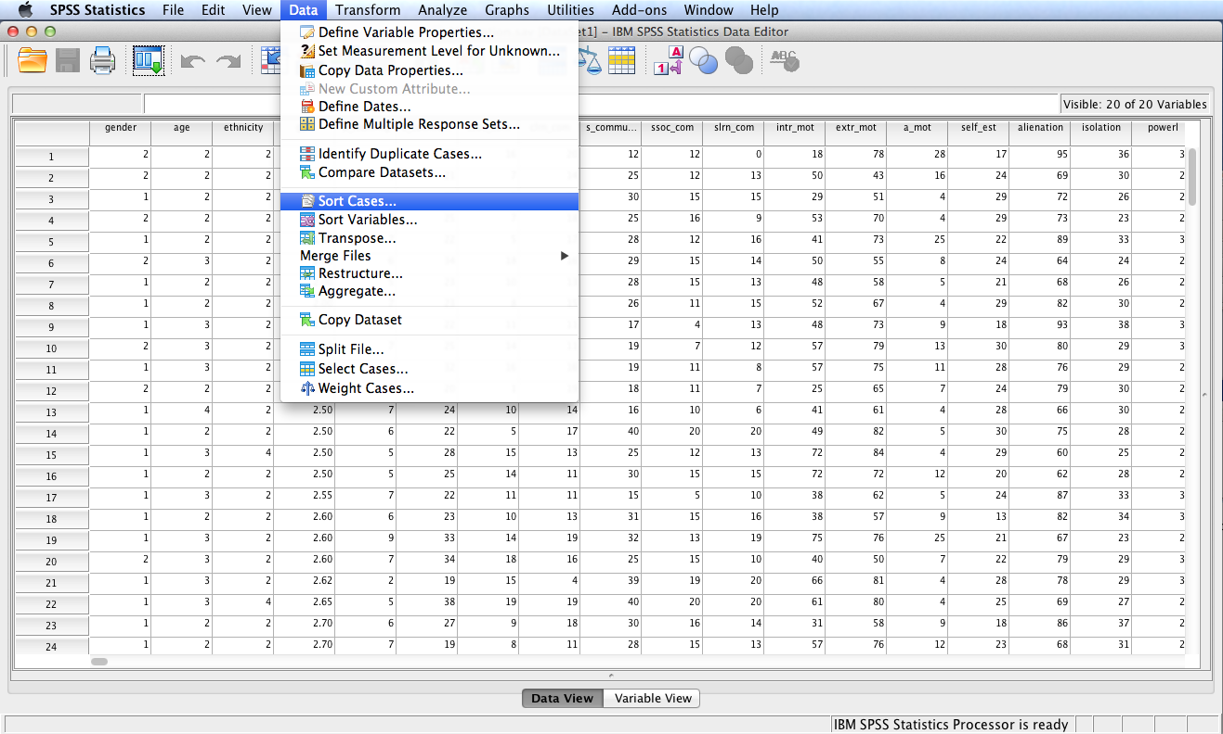
Follow the menu as indicated.

Slide 5
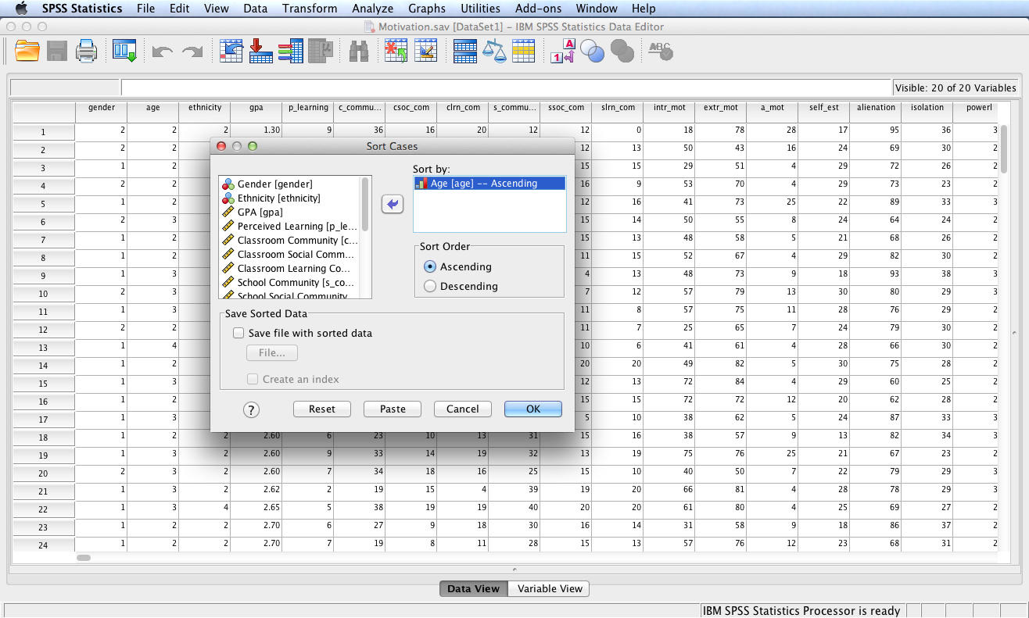
Move variable Age (age) to
the Sort by: box. Check the
ascending radio button for
Sort Order. Finally, check
the OK button.

Slide 6
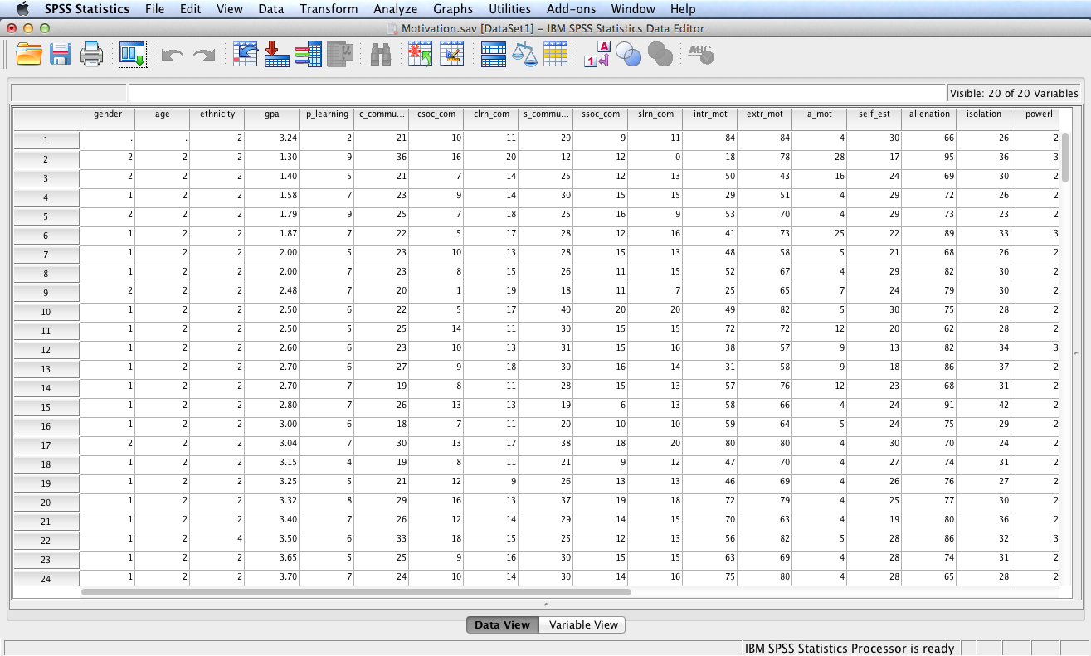
The dataset cases or now sorted
by age in ascending order.
TASK #2
Sort the dataset by variables based
on name in descending order.

Slide 7
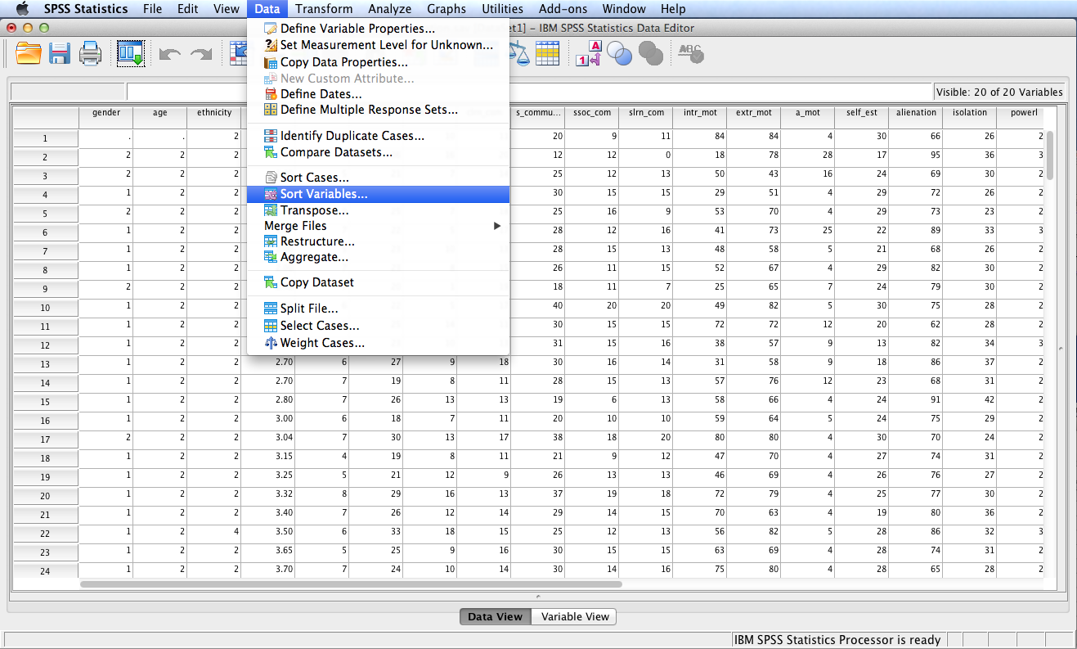
Follow the menu as indicated.

Slide 8
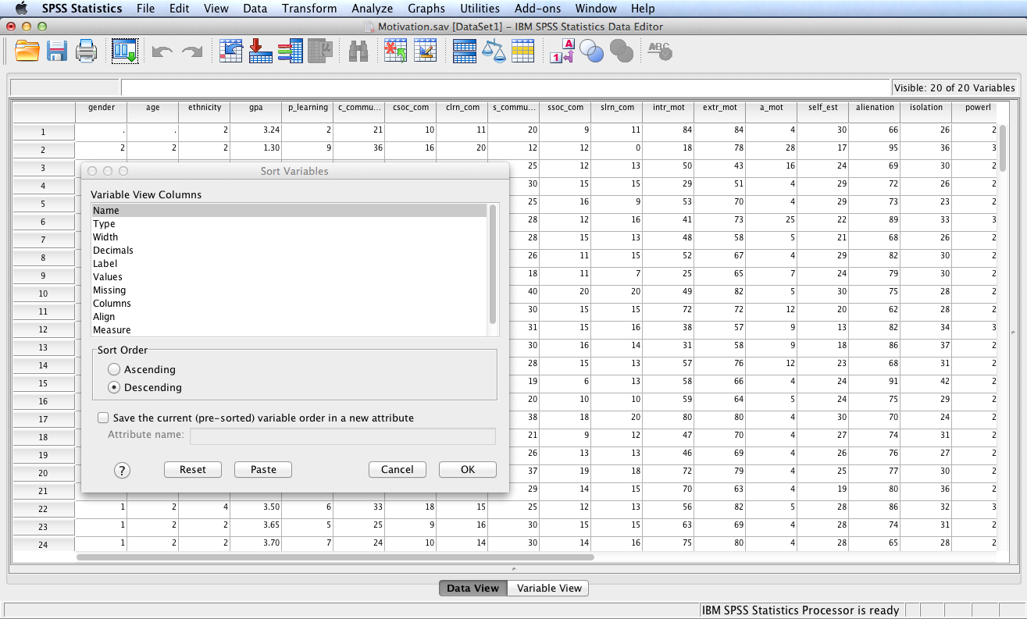
Next, select Name from the Variable
View Columns box, select the Descending
Radio button for Sort Order, and click the
OK button.

Slide 9
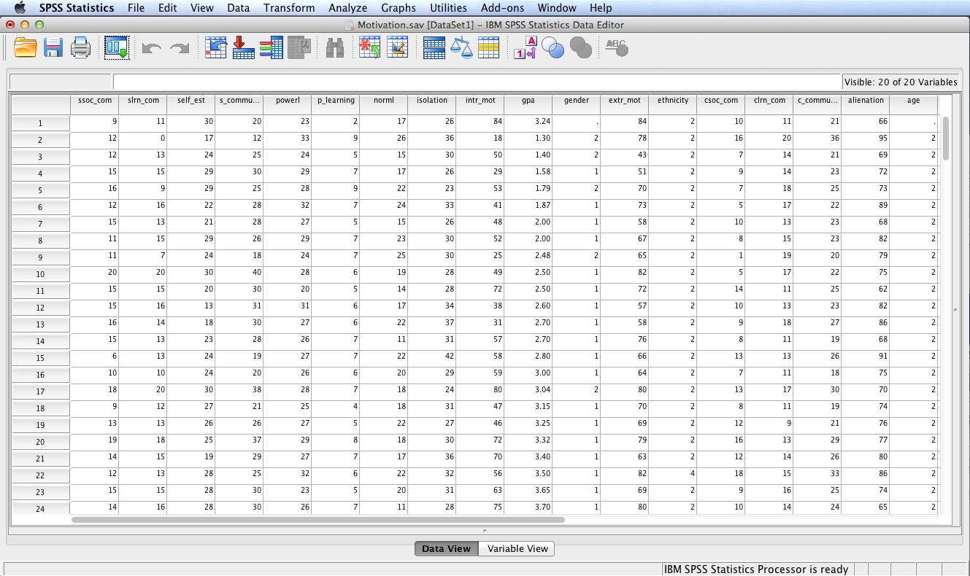
The dataset is now properly sorted. Save the modified file, perhaps with a new name, e.g., Motivation Sorted.sav, in order to distinguish it from the original file.

Slide 10
End of Presentation

